Slide 1
For & While loops
Fundamentals of Python Programming Chapter 6

Slide 2
Chapter Content
While Loop in Python
For Loop in Python
Nested Loops
Loop Control Statements
How for loop in Python works internally?

Slide 3
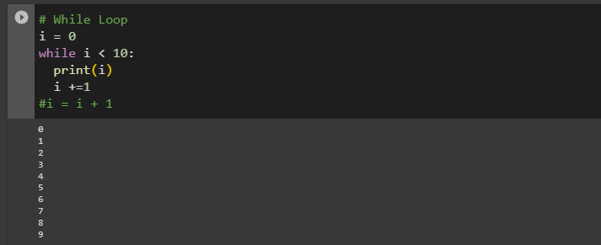
While Loop
In Python, a while loop is used to execute a block of statements repeatedly until a given condition is satisfied. And when the condition becomes false, the line immediately after the loop in the program is executed.

Slide 4
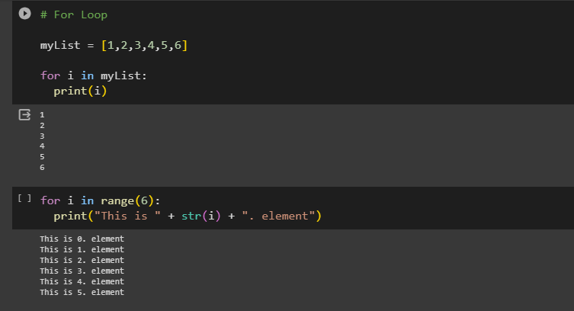
For Loop
A for loop is used for iterating over a sequence (that is either a list, a tuple, a dictionary, a set, or a string).
This is less like the for keyword in other programming languages, and works more like an iterator method as found in other object-orientated programming languages.
With the for loop we can execute a set of statements, once for each item in a list, tuple, set etc.

Slide 5
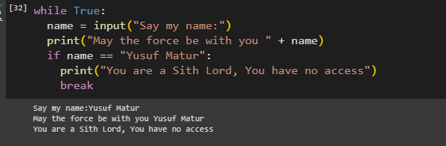
«Break» statement ın loops
It's worth noting that if Python doesn't terminate loops, they can loop endlessly. Therefore, when relying on a break statement to end a while loop, you must ensure Python will execute your break command.

Slide 6
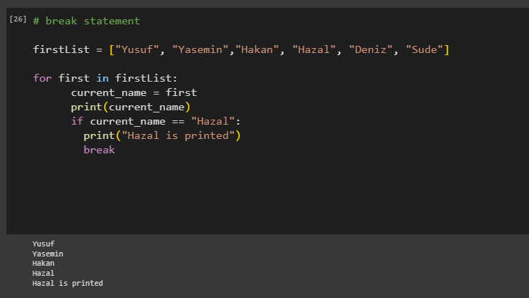
Break statement ın for loop

Slide 7
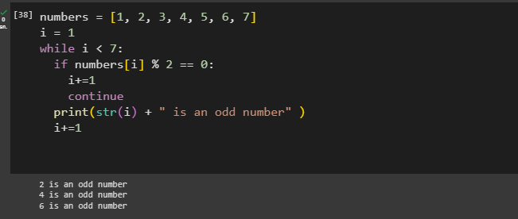
Continue statement ın loops
The continue statement in Python returns the control to the beginning of the while loop. The continue statement rejects all the remaining statements in the current iteration of the loop and moves the control back to the top of the loop. The continue statement can be used in both while and for loops.

Slide 8
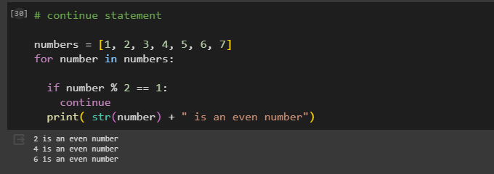
Contınue statement ın for loops

Slide 9
«Range» statement ın loops
The Python function range() generates a sequence of continuous numbers. It takes three parameters: the first is the starting number of the sequence, the second is the last number of the sequence and the third is the step of the sequence.
range(5): Generate numbers 0 to 5
range(5,10): Generate numbers 5 to 10
range(0,10,2): Generate numbers to 10 with difference between consecutive numbers is 2

Slide 10
«Break» statement ın whıle loops
It's worth noting that if Python doesn't terminate while loops, they can loop endlessly. Therefore, when relying on a break statement to end a while loop, you must ensure Python will execute your break command.

Slide 11
Continue statement ın whıle loops
The continue statement in Python returns the control to the beginning of the while loop. The continue statement rejects all the remaining statements in the current iteration of the loop and moves the control back to the top of the loop. The continue statement can be used in both while and for loops.

Slide 12
References
https://www.geeksforgeeks.org/python-programming-language/#python-operators
https://www.copahost.com/blog/python-range/#:~:text=The%20Python%20function%20range(),the%20step%20of%20the%20sequence.

